Slide 1

Understanding Data Part 3
Extracting Information from Data
(Condensed Version)
Notes:
Large Data Sets
Information(Data Science)
- gain insight and knowledge that are obtained from translating and transforming digitally represented information.
-see patterns when data are transformed
-filter, modify, combine and compare data
-visualize data through charts, graphs, tables and other visualizations
Tabular Data(2D data, excel)
Python Pandas
Scalability
Parallel vs sequential computing
Distributed computing
Analyze, Plot, Search, Filter, Transform Data, Data Cleaning
Extracting Information from Titanic Data Set
Correlation vs Causation

Slide 2
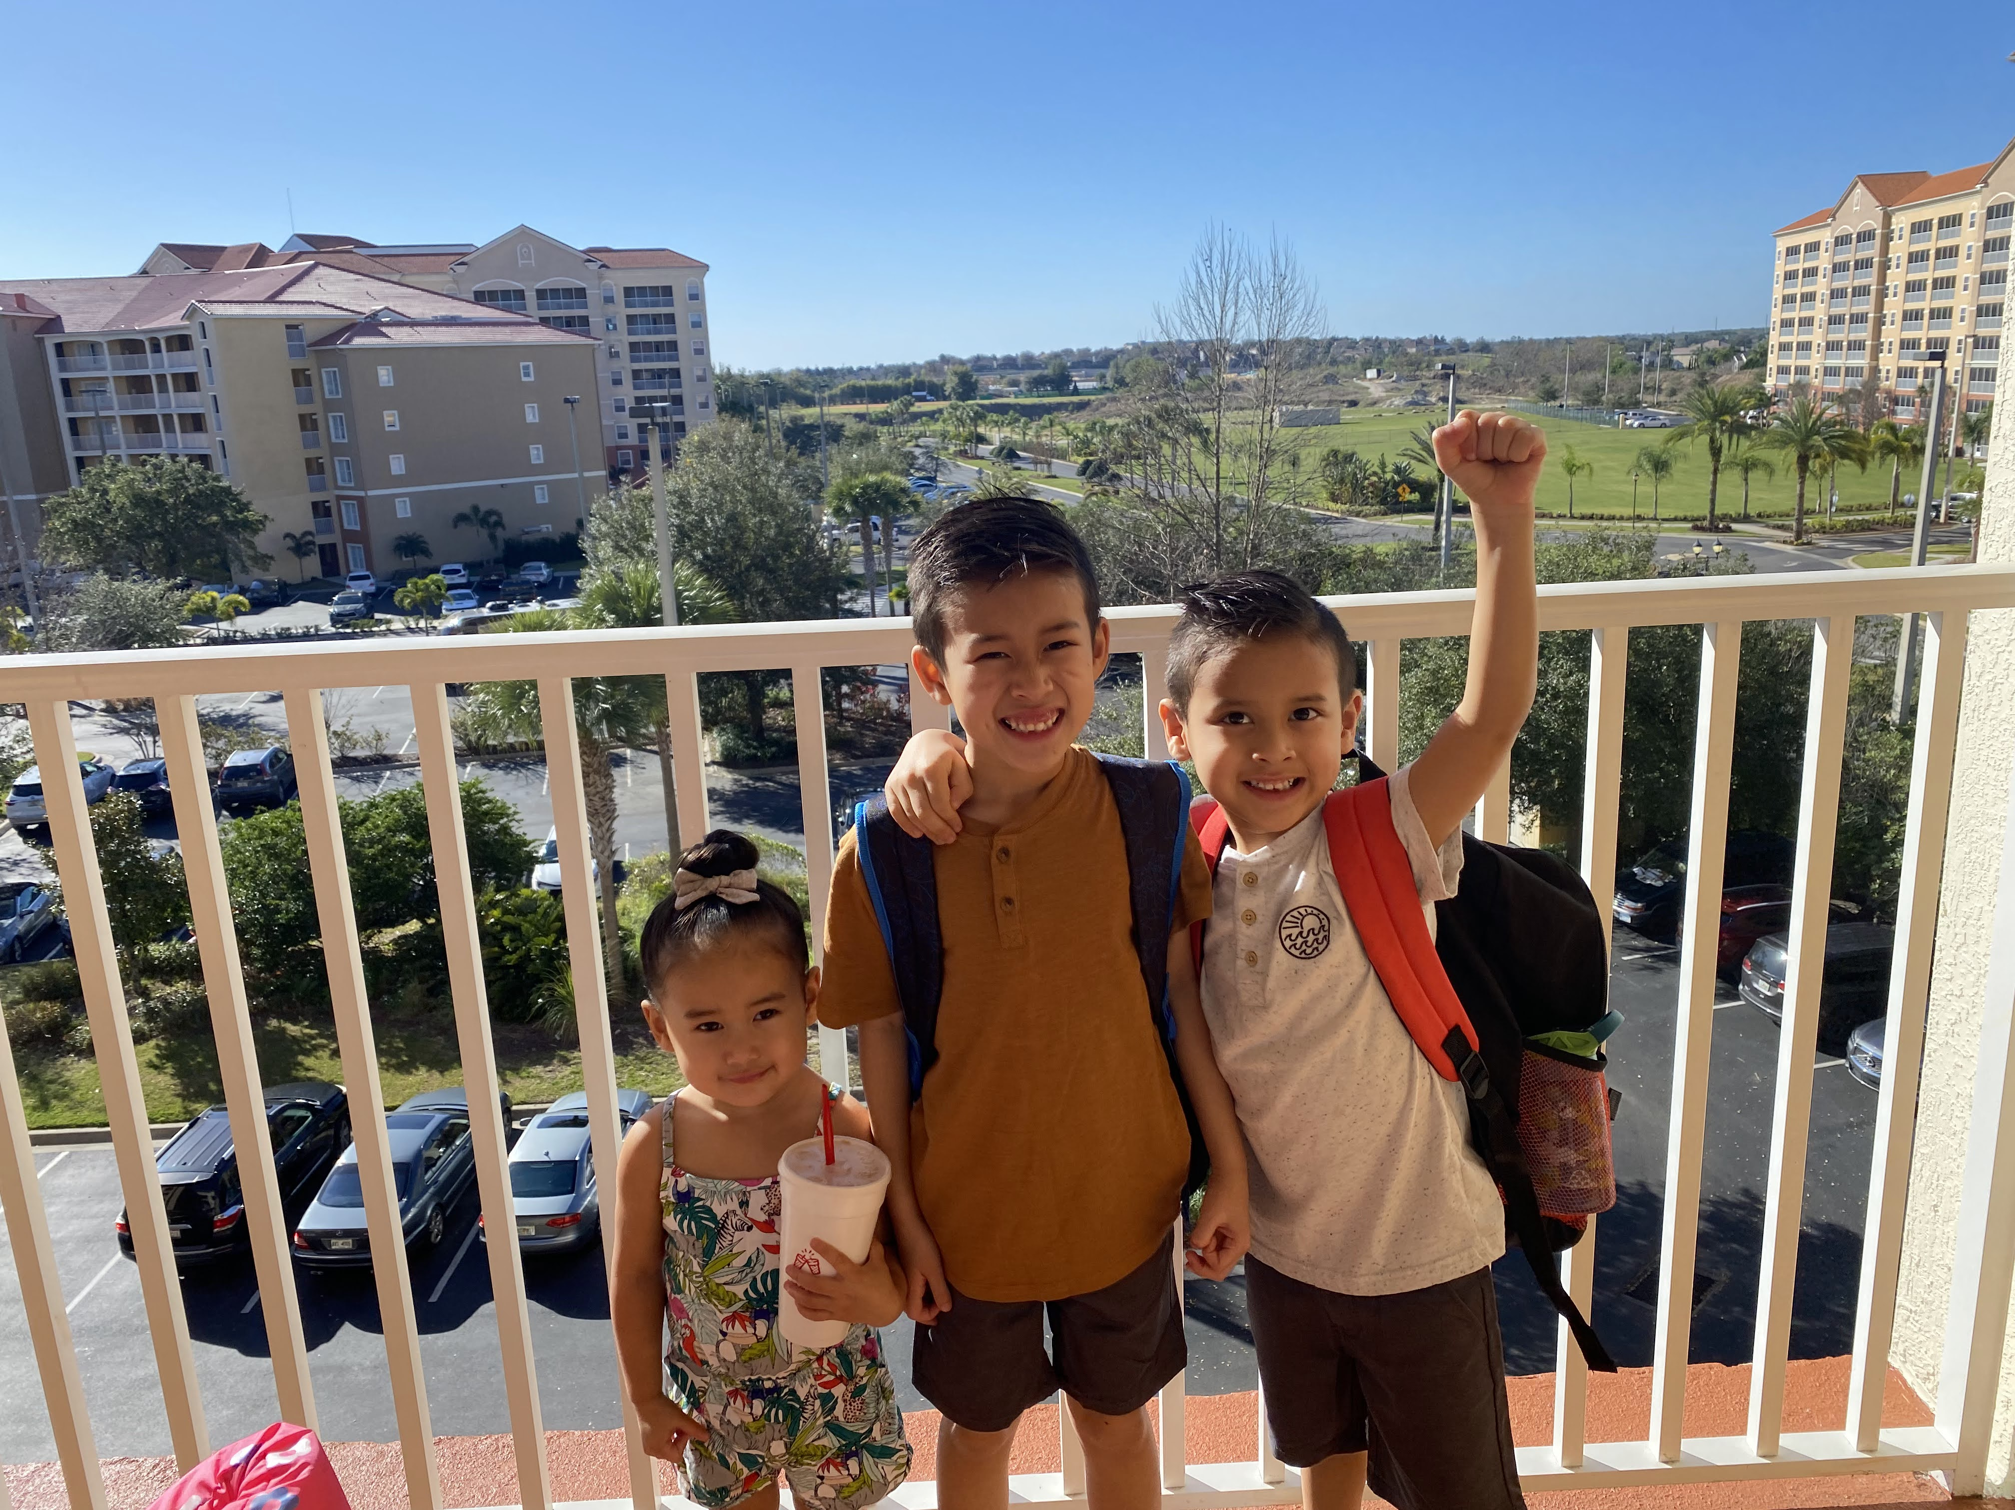
Lana, Mila, Rocco

Slide 3
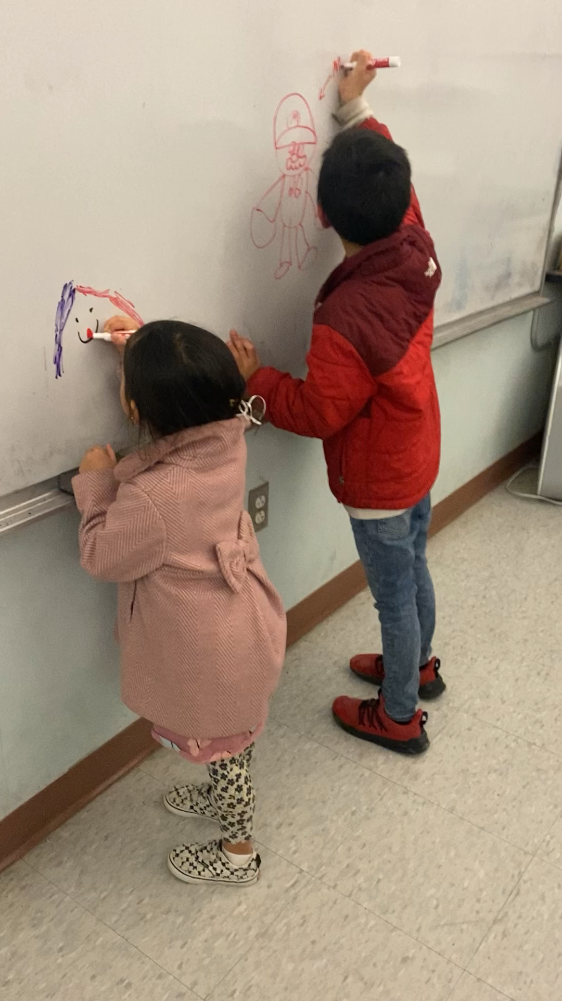
BLS Visit
Rocco and Lana came to visit VSS Tet’s Festival.(Mila couldn’t come)

Slide 4
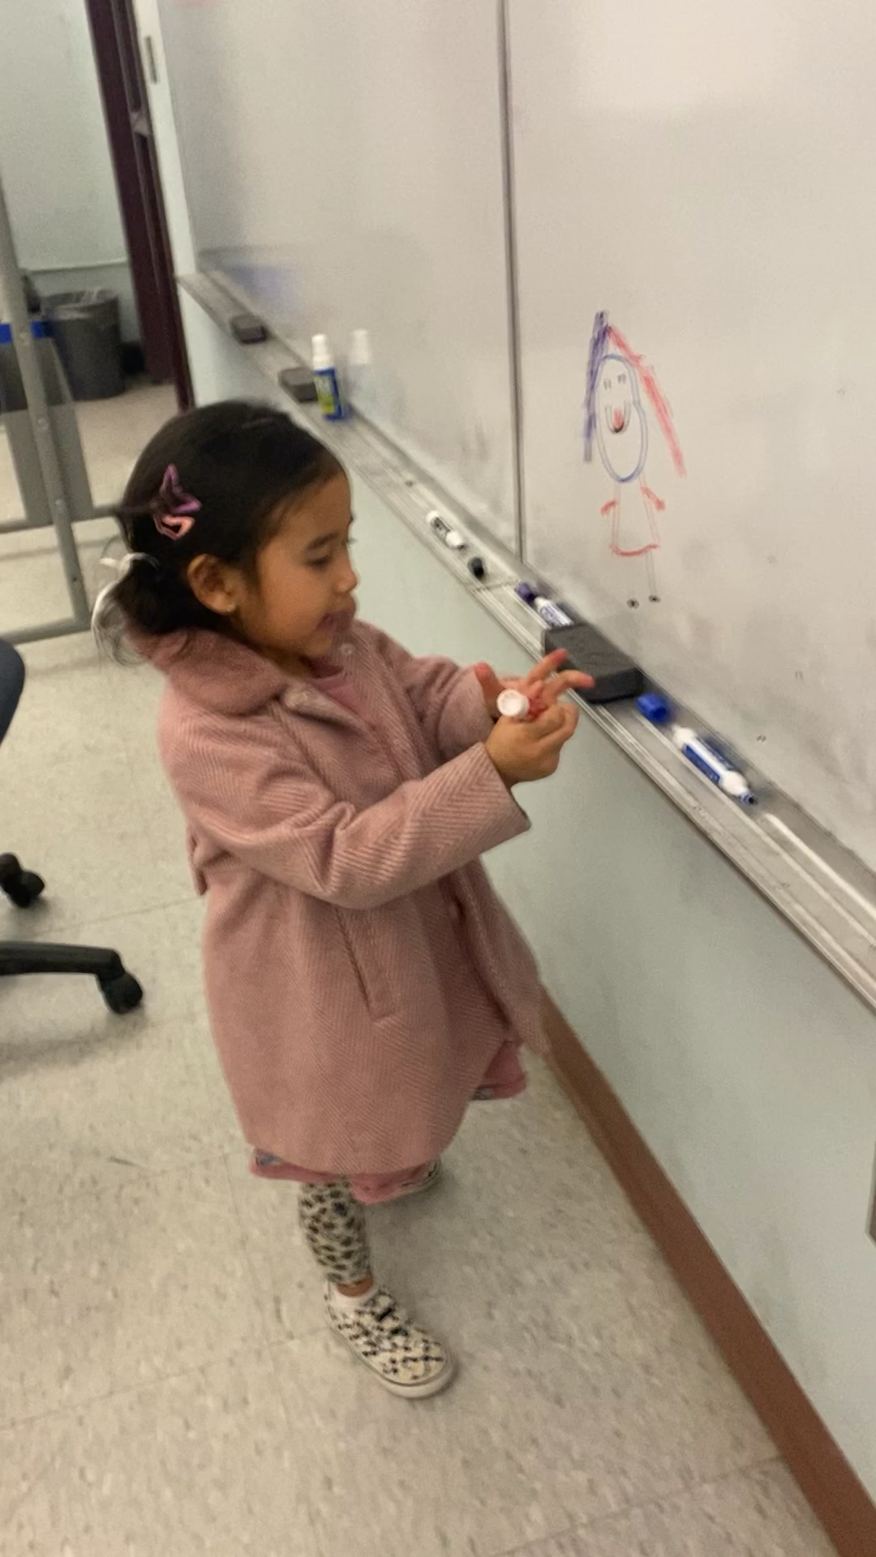

Slide 5
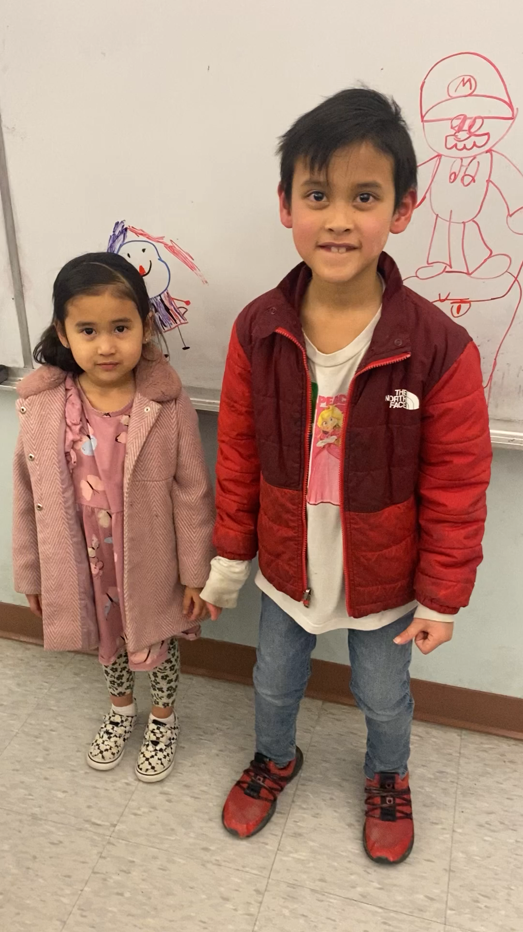
Announcement

